Slide 1
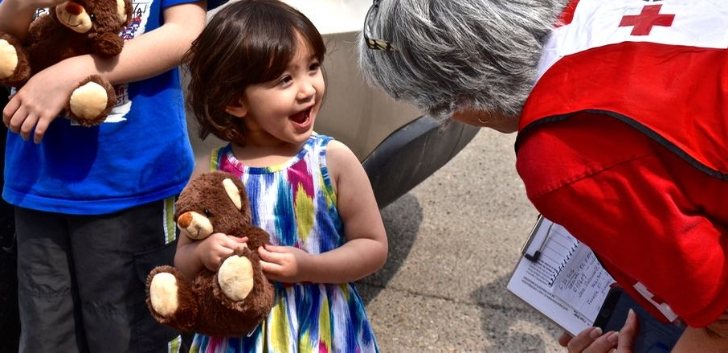
The Red Cross is there
Every day, we are present in your community.

Slide 2
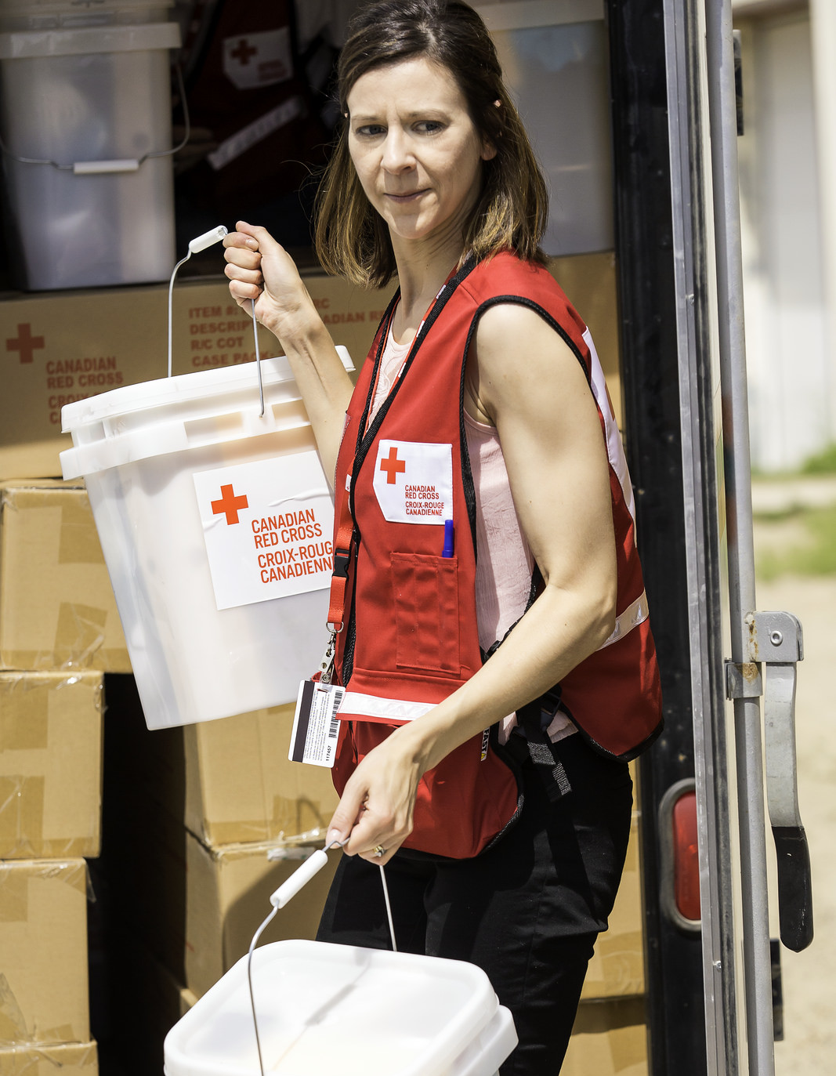
Our humanitarian commitment in Canada
    Every 3 hours, Canadian families call on our help and we assist on average 158 Canadians daily
    12,000 volunteers are active in our communities
    Our teams are ready to help those affected by disasters, 24/7
Notes:
Here at home, disasters affect families:
Every three hours in communities across the country.
These are mainly fires, which can cause a family to lose everything in the blink of an eye.
Community-wide disasters
The Red Cross is the primary partner of public authorities when it comes to disaster management
Support is based on the specific needs of families and communities
Canadian families can rely on volunteers trained in disaster response that are ready to respond 7 days a week, 24 hours a day. In Canada, 12,000 volunteers watch over their communities.
The Red Cross responds daily and is ready to respond during large-scale events that affect entire communities:
Since the onset of the fires in BC, more than 49,000 people have been forced out of their homes and Red Cross has provided thousands with emergency financial assistance.
Following the spring floods in Québec and Ontario, flooded households who registered with Red Cross received direct financial assistance. The Red Cross continues to support them throughout their recovery.

Slide 3
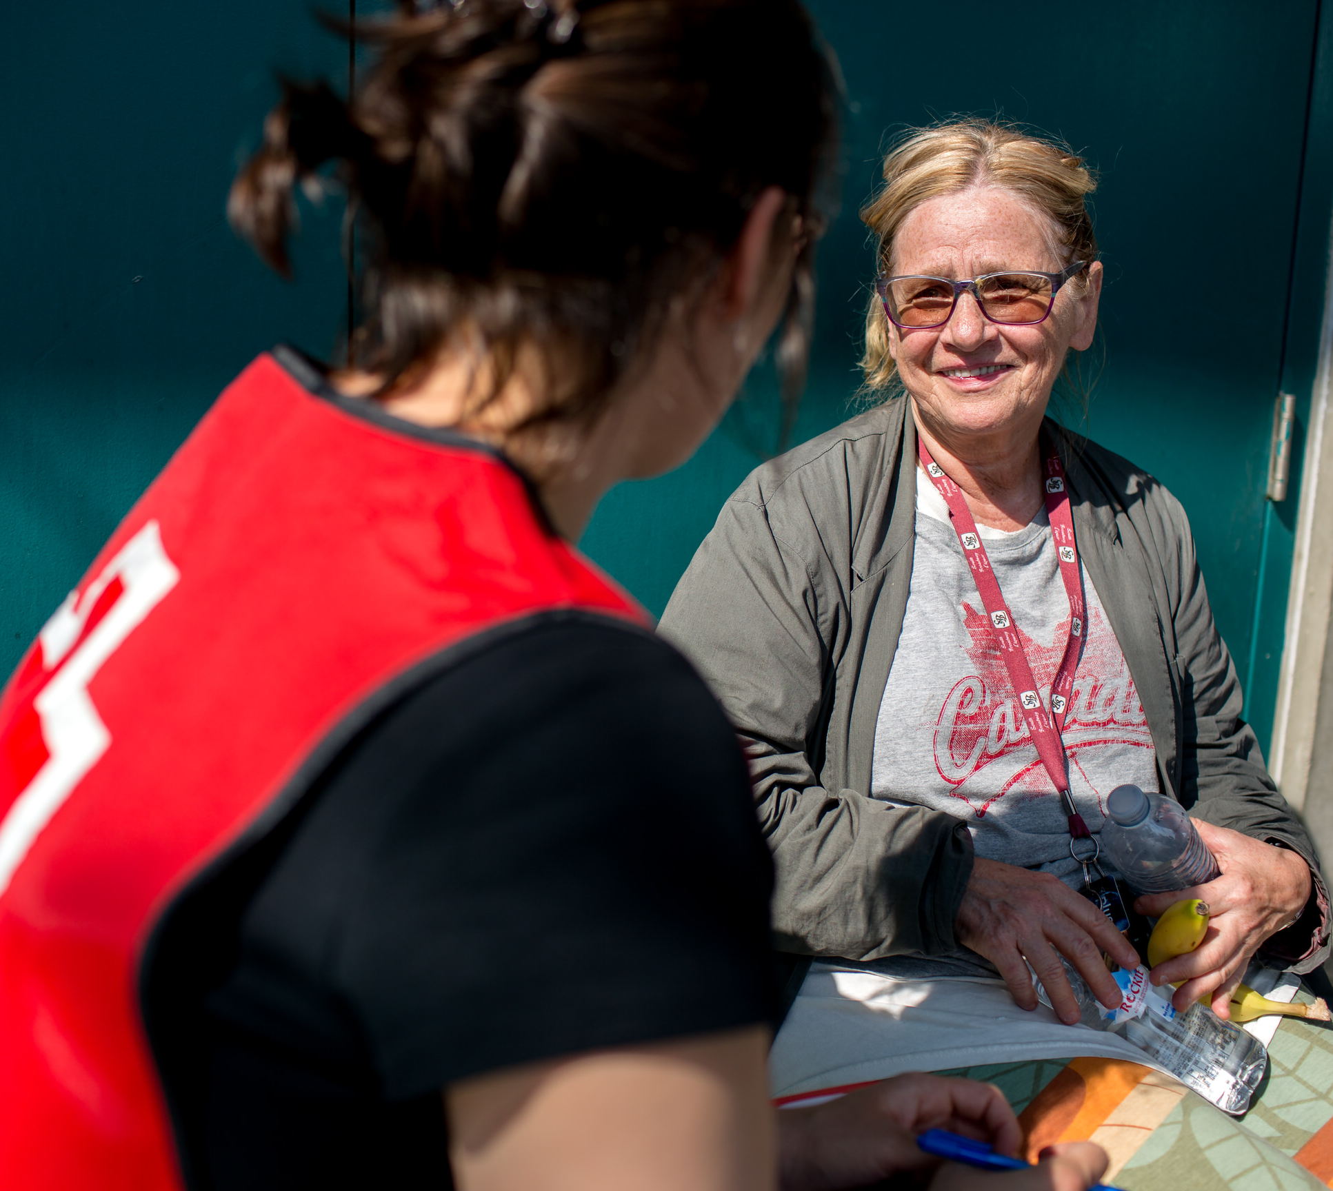
Our volunteers provide the essentials on a daily basis
    Comfort, support and information
    Shelter, food and emergency clothing
    First aid and personal services
Notes:
Red Cross volunteers watch over your communities and are trained to respond to emergencies.
Donations from people like you help meet essential needs such as shelter, food and clothing while providing emotional support in times of difficulty. Our teams also provide blankets, personal care kits, as well as stuffed animals for children and essential baby items.
The first three days after a disaster strikes are the most critical. Volunteers make sure to guide those affected so that they can take necessary steps to get their lives back together as quickly as possible.
Volunteers can also refer those affected to community organizations that offer additional assistance.
Our donors enable us to provide assistance that is not only practical, but is also deeply human, respects the dignity of disaster victims and is a fundamental source of comfort.
With your support, the Red Cross is there to provide the essentials.

Slide 4
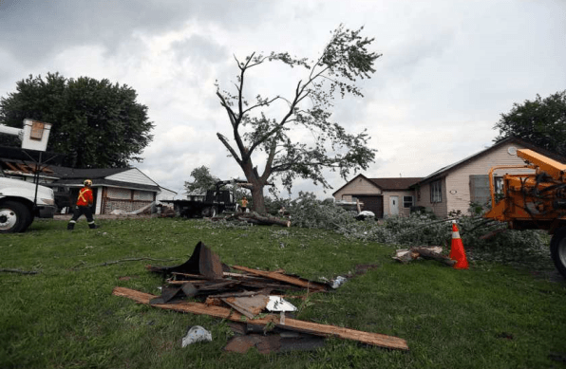
Your impact, in the midst of an emergency
    Arnold and his friend received emergency assistance from the Red Cross after a tornado destroyed their home in LaSalle, Ontario.
    “We were sitting in the carport when the storm came at us. We had no warning or time to prepare. It hit me really hard.
    The Red Cross came in and they helped me. They took care of me. ”
Notes:
Here is an example of the critical assistance the Red Cross can provide, thanks to donations:
“We were sitting in the carport,” Arnold said. “The storm came at us from behind. We had no warning or time to prepare.” Though he does not remember much else from that evening, he does recall the sense of panic and confusion he felt as the tornado touched down on the home the 60-year-old rented with a friend.
Volunteers supported them through this tough time:
“It hit me really hard. The Red Cross came in and they helped me,” said Arnold. “They took care of me.”
Thanks to your donation, Arnold and his friend received emergency assistance from the Red Cross after a tornado destroyed their home in LaSalle, Ontario.
Without you, none of our work is possible. Thank you!

Slide 5
Covid-19 – Novel Coronavirus
    During this pandemic, we are all impacted by a disaster
    Our staff and volunteers continue to provide essential Red Cross humanitarian assistance.
Notes:
The Canadian Red Cross is dedicated to supporting individuals, families and communities during the COVID-19 pandemic. Through relationships with government agencies and widespread community partnerships, the Red Cross continues to adapt to emerging needs to assist the country’s most vulnerable as this international crisis evolves.
Here are some examples of how the Canadian Red Cross is helping or has helped so far:
Virtual care and friendly calls
Offering virtual care over the phone in Quebec, Ontario, Nova Scotia, New Brunswick, Newfoundland and Labrador and Prince Edward Island to provide referrals, guidance and emotional support to help people through their isolation period. There is also a Friendly Phone Program in Saskatchewan to reach isolated seniors.
Assisting vulnerable populations
Providing supplies, including cots, blankets, and clean-up kits upon request by local authorities to various locations across the country to help support vulnerable populations.
Operating a call centre on behalf of the City of Toronto to ensure that vulnerable individuals in isolation have a mechanism for receiving food. Food hampers are then delivered to those in need of assistance.
In partnership with the City of Ottawa, Red Cross is going door-to-door to determine how isolated individuals are coping, and to ensure their immediate needs are met, which includes food and medicine supply.
Working with Indigenous communities
Building off a long history working alongside Indigenous communities, the Canadian Red Cross is working in partnership with Indigenous Services Canada to help communities across the country to prepare for and respond to COVID-19.
Supporting community organizations
Thanks to funding from the Government of Canada’s Emergency Community Support Fund, led by Employment and Social Development Canada, the Canadian red Cross is making grants, training and personal protective equipment available to community organizations across the country, as they deliver services to those who are the most vulnerable to the health, social and economic impacts of COVID-19.
Deployment of field hospitals, training and Health Equipment distribution
Components of the Canadian Red Cross Emergency Field Hospital have been sent to Vancouver and Montreal to augment existing health infrastructure in response to the COVID-19 pandemic.
Distributing additional equipment through the Health Equipment Loan Program (HELP) to assist Canadians recovering at home from surgery or illnesses. The need has increased for equipment such as wheelchairs, walkers, commodes, hospital beds, and IV poles to support people in their recovery at home.
In Quebec, Canadian Red Cross personnel are organizing and delivering personal protective equipment (PPE) and prevention of disease transmission training for people in the health network and those newly recruited who will help provide support in seniors housing.
Services to Canadians returning home
At the request of the Public Health Agency of Canada, the Red Cross is providing comfort and care services to Canadians returning to Canada in seven locations: Vancouver, Calgary, Toronto, Montreal, Fredericton, St. John’s and Halifax. Services include registration and information services, the provision of personal items, meal delivery service, safety and wellbeing support, and family reunification.
For updated information, please visit our website at https://www.redcross.ca/

Slide 6

Financial snapshot (2019)
87%
Program expenses
10%
Fundraising expenses
TOTAL SPENDING
3%
Governance & General Management expenses
Notes:
The funds raised by the Red Cross during fundraising campaigns are managed entirely by the organization. No money is transferred to other organizations: 90% of the funds raised annually are dedicated to the provision of services to the public

Slide 7
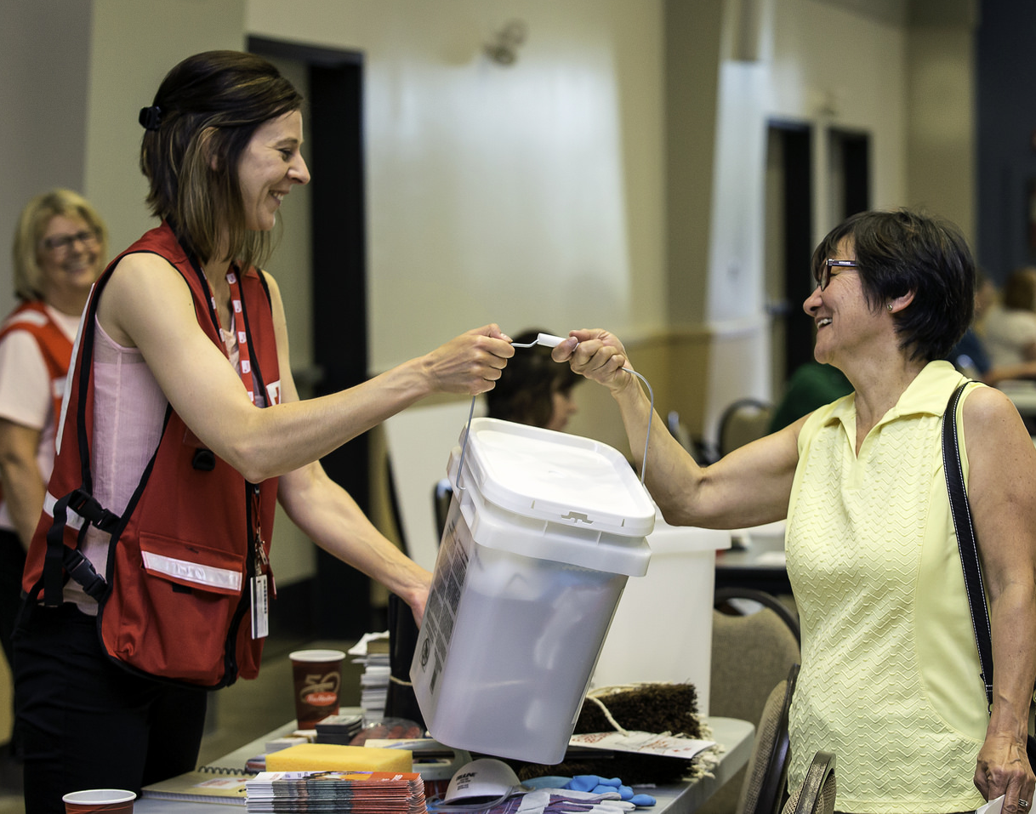
Your generosity at work
    1.2 million Canadian donors have given more than $1 billion in funds since 2010
    Every year, you are there.
    Thanks to donors like you, the Red Cross is ready to assist those in need.

