Slide 1
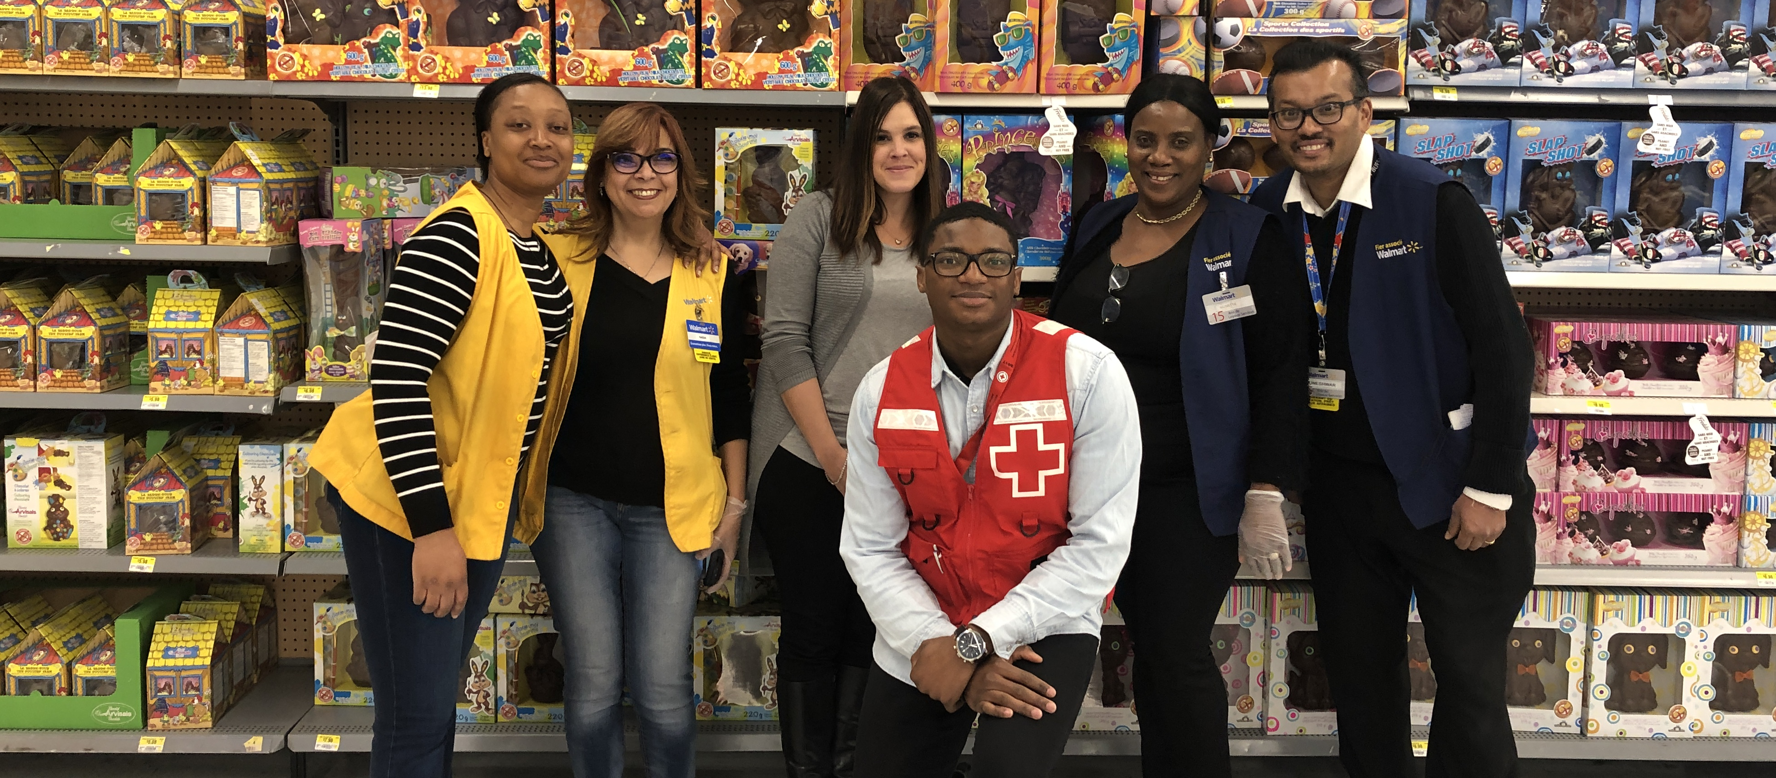
2020 Walmart Red Cross Campaign

Slide 2
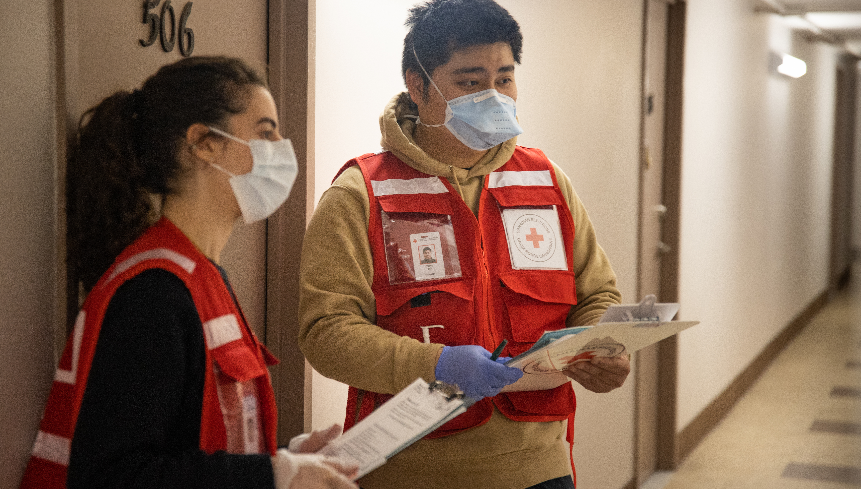
The Campaign

Slide 3
Background
Walmart over the years
First campaign was in 2003
The campaign is now in its 17th year
Walmart has raised over $50 million for emergency response and preparedness
National goal for 2020 is $2.5 million
Walmart will match up to $2,000 per store and up to $820,000
Notes:
Since 2003, Walmart stores across Canada have dedicated several weeks each year to support the Canadian Red Cross with a fundraising campaign.
The campaign now in its 17th year has been a cornerstone in disaster response and preparedness and has raised and donated over $50 million
Funds raised from this nation-wide campaign provide vital dollars in support of disaster response in Canada.
Natural disasters are occurring more frequently than ever before. Large scale forest fires, significant floods and ice-storms have affected tens of thousands of Canadians in the past few years.
This year so far has been no less challenging for all Canadians with the onset of the global COVID-19 pandemic.
The national goal for this year’s campaign is $2.5 million plus Walmart will match up to $2000 per store and up to $820,000.

Slide 4
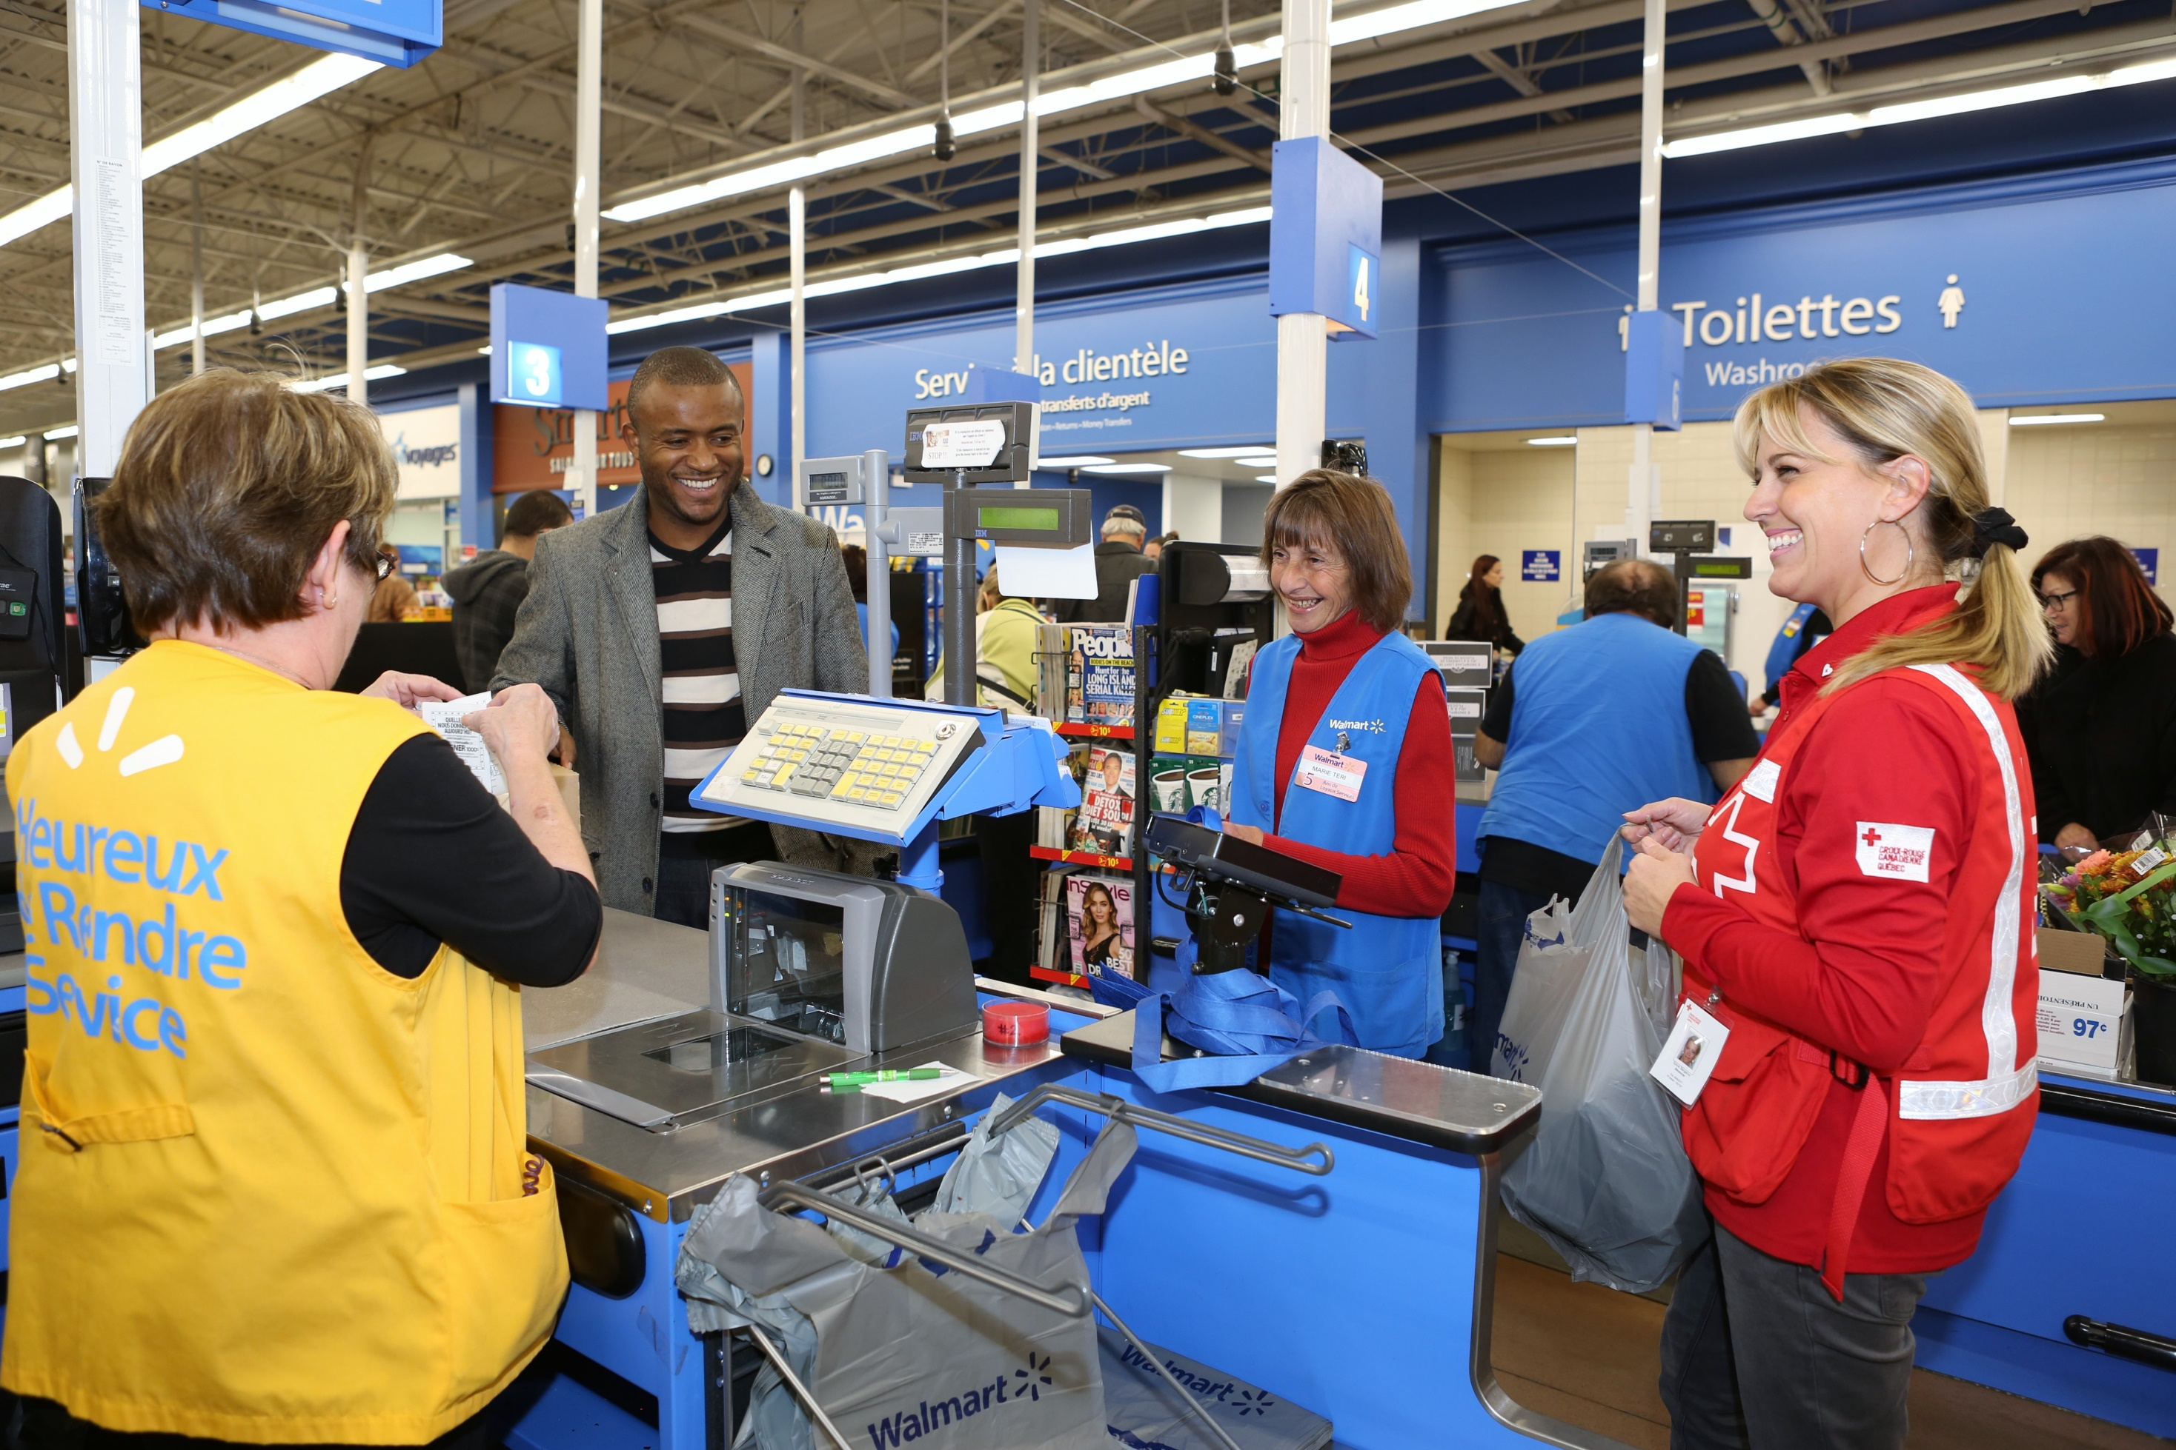
How the Campaign Works
A 4-week “ask at cash” campaign
At check out, Walmart cashiers ask customers if they want to donate
Customers can donate $1, $2, $5 or more
Customers can also donate at the self-checkout kiosks
Notes:
This annual 4-week initiative is an “ask at cash” campaign that is executed at the store level by the associates and is supported by the management and Market Leaders at Walmart.
When a customer comes through their till, cashiers will ask customers if they “would you like to support families who need the Red Cross?” If customer says yes, the associate scans the card. Each scan of the icon’s barcode adds $1 to the customer’s bill. If the customer would like to make a larger donation, the cashier will scan the card to equate to the customer’s requested donation amount OR, the cashier can scan the bar code on the info card and input the dollar value of the donation. This is helpful if the customer wishes to donate $5 or $10 dollars or more.
Customers can also donate at the self-checkout kiosks. The customer will be prompted to donate $1, $2, $5, or given the option to decline.
Walmart will match donations raised in their stores up to $2,000 per store.
These matching dollars are helpful in motivating the associates and our Red Cross Walmart Ambassadors to ensure we receive the maximum amount of matching dollars.

Slide 5
Ambassadors
Importance of Red Cross virtual ambassadors
Play a crucial role
Are a unique feature of the Red Cross campaign; you are the brand ambassadors
Support the campaign by providing information on how the funds raised are used
Are there to thank Walmart Associates for their support
Recognize and thank Walmart staff & associates
Notes:
Red Cross Walmart Virtual Ambassadors play a crucial role in our annual in-store campaign
Walmart conducts nation-wide fundraisers for other organizations, but Canadian Red Cross is the only organization that has volunteers who support the campaign in every store across the country. This makes Red Cross unique and stand out.
Red Cross ambassadors provide the information, attention and recognition required by Walmart associates, managers and customers that make this campaign as successful as it is each year.

Slide 6
Key Campaign Timelines
Timeline | Action
June 10th – 26th | Ambassador Training via video/telephone
June 18th – 26th | Initial Contact with Store Manager
By June 26th | Campaign Support Package for Store Lead
June 22nd – 30th | Campaign Kickoff Call
July 2nd | Campaign Begins
Weekly throughout the Campaign | Store Follow – Up (Campaign Leads/Store Manager – and Associates if possible
Mid Campaign | Store Associate Interview
July 31st | Campaign Ends
August 3rd – 7th | Thank You Call
Notes:
Refer to Volunteer Resource guide & reference table
Emphasize on Purpose and Assets & Action required
Key emphasis on yellow highlights

Slide 7
Campaign Materials

Slide 8
In-store Materials
Check-out Sign
Front
Cash Register Cling
Check-out Sign
Back
Notes:
Walmart produced Materials
These items are designed by Red Cross, printed by Walmart and distributed to their stores prior to the campaign via Walmart’s Blue Bag (internal mail).
Cash Register Cling: Clings with campaign creative will be posted on the light boxes above the cash registers.
Check Out Sign (Plexi-poster): These campaign information posters will be posted in or around the checkout area, commonly on plexi-glass screens that are being used to help protect customers and associates during COVID-19.
Not shown is the Info card: This is the card that associates use to scan donations from customer.

Slide 9
Self-Serve Checkout Imagery
Notes:
There is also imagery in the self-checkout kiosks. The customer will be prompted to donate $1, $2, $5, or given the option to decline

Slide 10
Notes:
Goal Poster: The goal poster is a thermometer style design that keeps associates updated on their progress toward the store’s campaign goal.
Thank You Poster: Thanks customers (and Associates) for their support during and after the campaign

Slide 11
Red Cross Campaign Box – shipped to stores
Campaign Playbook
Buttons (Bag of 100)
Campaign Quick Reference
Fundraising Star Tracking Sheet
Fundraising Star Pins
Notes:
Red Cross Campaign Box – shipped to stores to arrive by June 26, 2020
• Campaign Playbook: Everything that the store lead needs to support a successful campaign in a 16-page booklet.
• Buttons (bag of 100): Encourage associates to wear buttons to show their support and promote the campaign. This year they are bigger and more of them!
• Campaign Quick Reference: Allows associates to get the quick details about the Red Cross campaign.
• Fundraising Star Tracking Sheet: Used to record associates who raise $500 or more. Fundraising Stars are recognized with a certificate and Fundraising Star pin!
Can also be found on Walmart’s intranet (The Wire).
• Fundraising Star Pins: A supply of these to recognize the Fundraising Stars in your store. Issued along with certificate.

Slide 12
Materials on Walmart intranet (The Wire)
Campaign Video:
Editable Event Poster:
Fundraising Star Certificate
Campaign Newsletters
Weekly Campaign Update Video
Notes:
New this year, the following material will be posted on the Walmart Intranet – The Wire
• Campaign Video: 1-minute photo montage with a thank you message. Ask your store lead to play where appropriate (e.g. front of store).
• Editable Event Poster: This poster is an excellent tool for in-store fundraising events – associates simply fill in their store event details in the editable fields, print, and distribute as appropriate.
• Fundraising Star Certificate : It is important to identify those associates who go above and beyond what is expected of them. The Red Cross has developed the Fundraising Star program to recognize associates who raise $500 or more through POS donations or other fundraising initiatives. Each Fundraising Star receives a Fundraising Star certificate to celebrate their efforts.
• Campaign Newsletters: Serve as a great engagement piece to share with associates. Each issue contains a Red Cross story, campaign highlights and photos, and a letter of encouragement from a Red Cross staff lead.
During your campaign check-in meetings, be sure ask the campaign lead or store manager if they have received the latest weekly newsletter and if they haven’t, offer to share a digital copy with them.
• Weekly Campaign Update Video: This short weekly video will be sent to the store by you (or possibly the Operations Assistant) and will provide a quick update on the campaign, key activities and a shot of inspiration.

Slide 13
Expectations and Responsibilities

Slide 14
Supporting Walmart Stores Virtually
What’s new for Campaign 2020
COVID-19 restrictions and physical distancing
Shift away from in-person store visits
Prioritize Ambassador safety and adherence to guidelines set out by local health officials
Notes:
As we all adjust to our respective “new normals”, physical distancing has become a part of everyday interactions for just about everyone. In adherence with health officer guidelines and an obligation to keep CRC volunteers/staff and Walmart Associates safe, Ambassadors will support the campaign virtually through phone contact and if possible, video meetings.
CE staff may wish to talk about local restrictions (or relaxed restrictions) and managing expectations of stores that request in-person support or meetings.

Slide 15
Key Campaign Activity
Key Touchpoints
Initial contact with store (commencing June 18)
Campaign kick-off call (commencing June 22)
Weekly store follow-up
Store associate interview (Mid-Campaign)
Thank you (August 3 – 7)
Notes:
Refer to Timelines and Key Activities in the Volunteer Resources-Reference Guide.
This lists available tools like scripts/talking points, checklists and video. For each of these key touch points, be sure to reference Ambassador Talking Points in the Volunteer Resources-Reference Guide for virtual meeting content guidelines.
Following training as early as June 18, Ambassadors should:
Reach out to make initial contact with store managers
Identify and introduce as CRC Ambassador
Determine charity lead(s)
Check if materials have arrived
Book a kick-off call date and time.
Note: charitable campaigns may be dealt with differently from store to store or different terminology may be used, i.e. campaign champion, charity committee, compliance officer, etc. Be sure to record pertinent store related information like Store and/or Front-end Manager names, charitable committee leads and any preferences around timing of calls.
Prior to the beginning of the campaign on July 2 schedule and complete a Kick-off call with the store. The key accountabilities for the Kick-off are to:
Welcome store and Associates to the Campaign
Deliver message of thanks to Associates for the work that will go into the Campaign
Review details, inspire store lead and associates by educating on the impact Campaign has on RC work
Review Fundraising Stars initiative.
Weekly check-ins and follow-up are a chance for Ambassadors to:
Give and receive store updates like store totals and newsletters that will be relayed to Ambassadors regularly to use as talking point
Collect any feedback or input from stores
Learn about and recognize Fundraising stars
Gather any stories or pictures (with info release forms) that might be suitable for newsletters or future campaign materials.
Interviews with store associate
INSERT DESCRIPTION RATIONALE AND INTENDED USE
Ambassadors can submit collected interview information via link to smart sheet
Thank you calls should be made immediately following the end of the campaign (July 31).
Relay campaign updates and store results
Recognize and thank store/charity leads
Collect any additional information on Fundraising Stars

Slide 16
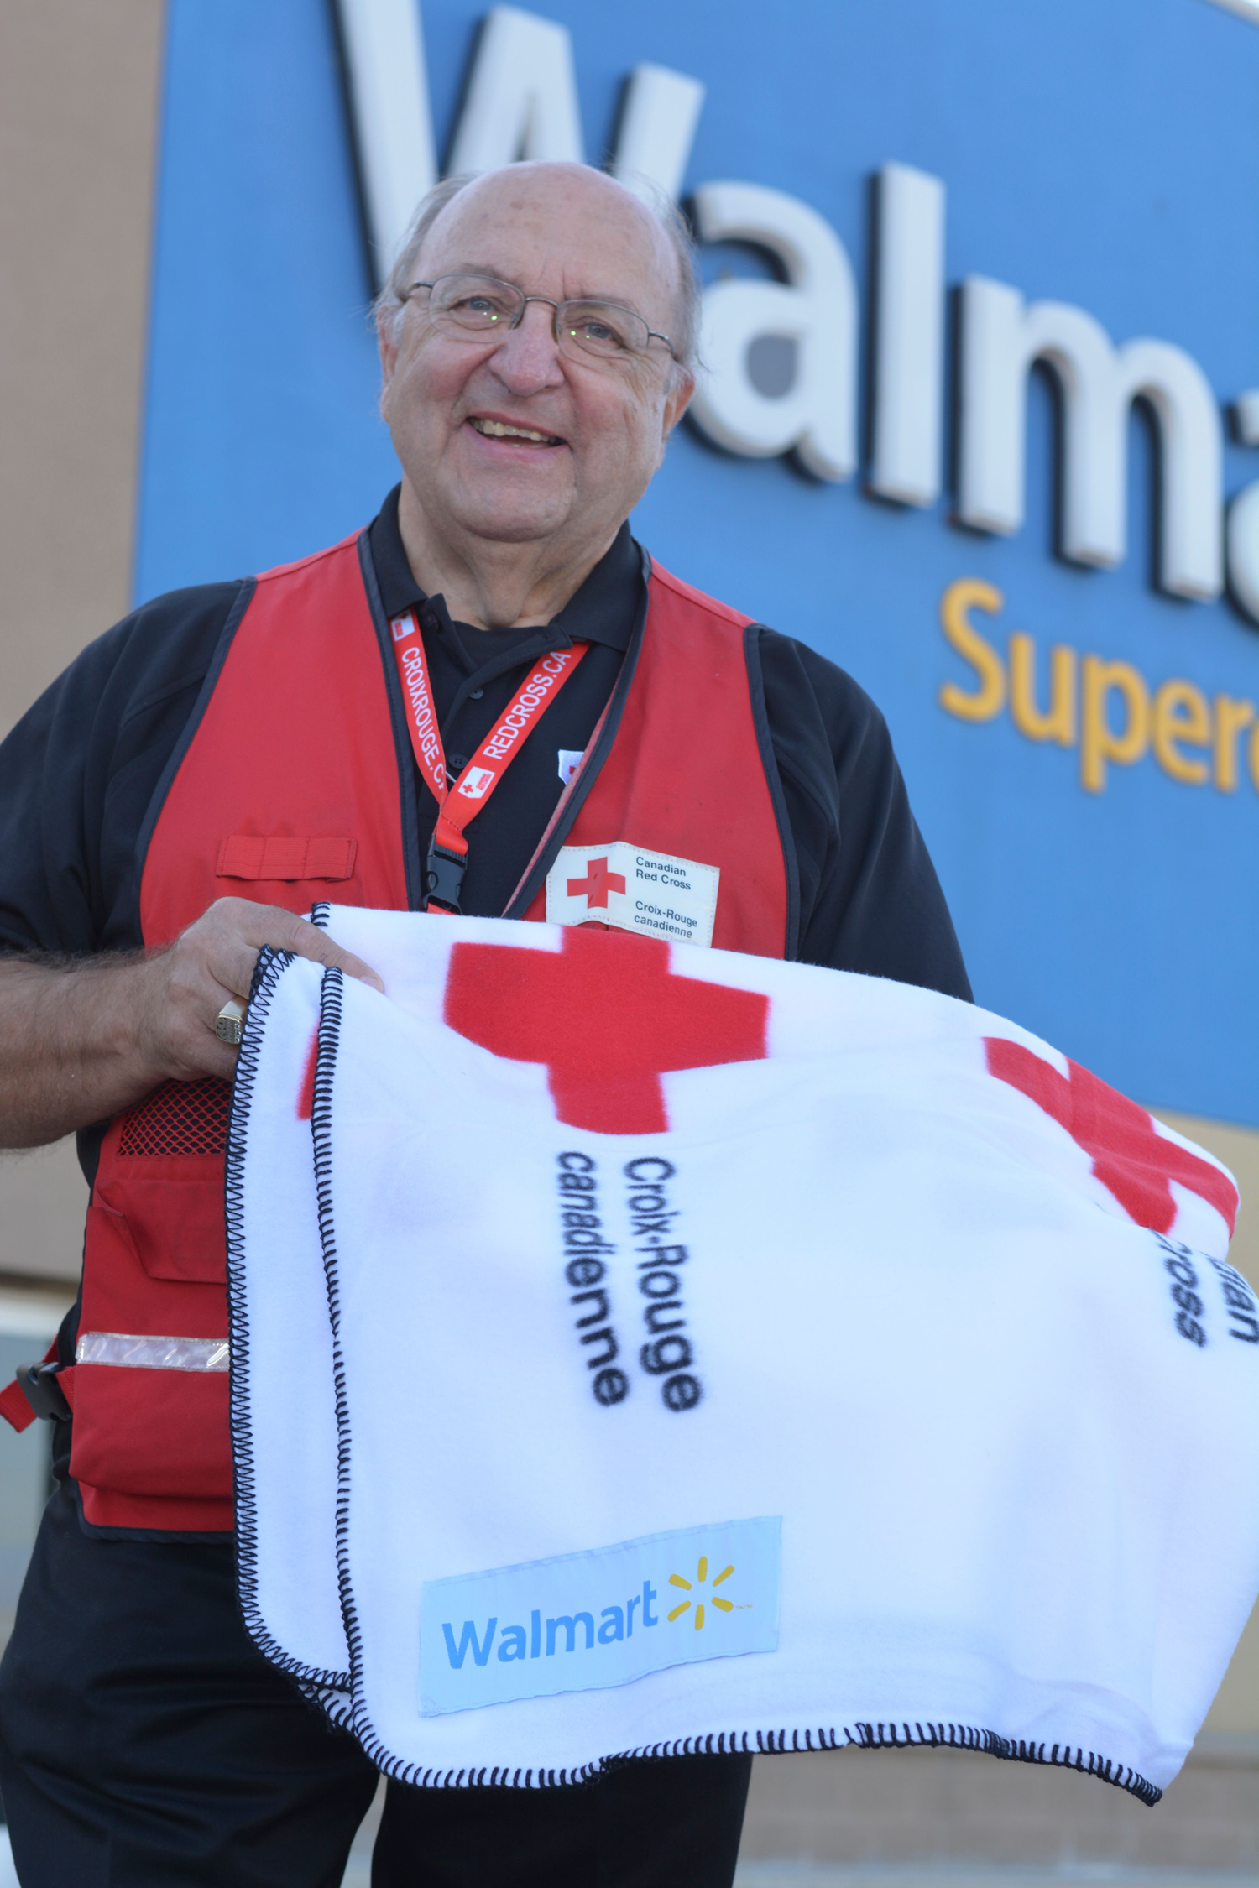
Fundraising Stars
Recognizing Associates Raising $500+
Ambassador Role
Notes:
As outlined above, Associates raising $500+ are recognized with a pin and certificate.
Ambassadors should inquire about names of Associates achieving this goal during weekly check-in/follow up calls and relay collected information to provincial Community Engagement staff.

Slide 17
Walmart Stores & Associates: Campaign Perspectives
Expectations and Considerations
Possible Objections or Challenges
Notes:
As a national charity partner to Walmart, there is an expectation of store managers and leaders to have some knowledge of the Canadian Red Cross campaign and be responsible for driving enthusiasm of associates and customers to support. Know that feedback from Walmart Home Office (corporate headquarters) on Canadian Red Cross volunteer support to stores locally is consistently positive and encouraged each year when strategizing campaign details at the leadership level.
For the most part, Ambassadors report positive and sometimes inspiring or heart-warming interactions with stores and associates through this campaign. However, there are many factors that will affect the response to your outreach and touchpoints that you should be aware of:
Walmart is committed to positively impacting the communities they serve. As such, they run fundraising campaigns for other worthy charitable partners throughout the year in addition to fundraising for local grass roots initiatives. “Campaign fatigue” and consequently “donor fatigue” may be cited as a challenge. Stick to key messages and re-iterate the impact this campaign has on our work.
Mind that many managers and campaign leads are familiar with the campaign and have done it for many years, be prepared and concise in conveying your message.
There are certain times of the day stores may see high customer volume or staffing levels may be too lean to take your call. Try to determine the best days and times, don’t be afraid to be persistent.
Manager/Associate re-assignments and turnover can be frequent which can make getting in contact with the appropriate staff lead challenging. Again, courteous and respectful persistence is key.
Staffing levels added responsibilities and compliance with current health and safety measures while the nation copes and adapts to life in the age of COVID-19 may potentially affect the resources available to respond to your inquiries. As Red Cross actively supports COVID-19 related response work, empathize with managers/staff and reassure them that your role is to support them in reaching their fundraising goal.
Stores that face pressing and urgent priorities (high rates of theft, high volume/high traffic locations) may seem uninterested in engaging. Reiterate your appreciation for all they do and express your willingness to support, relay feedback or resolve any campaign related issues.

Slide 18
Role Play
Positive Interaction/Outcomes
Interaction with possible challenging interaction
Feedback and suggestions
Notes:
Relationship managers will play the role of Walmart staff to allow Ambassadors to see how an interaction with stores may turn out. Try to give a positive and a more challenging example for at least the Initial Contact Call and a Kick-Off Meeting Call.
Initial Contact and Intro Call
Positive Interaction – give the Ambassador the answers and details needed to confirm key information like charity lead(s), preferred date and time to have a kick-off meeting, equipment/technology needs for a kick-off call, etc.
Challenging Interaction – make it difficult for Ambassador to relay or solicit information by being rushed, not providing key information, requiring multiple call-backs, expressing no knowledge of campaign, etc. Reiterate the need for patience, appreciation of WM staff and their support, and the impact of the campaign
Kick-off Meeting – Role Play & Feedback
Positive Interaction – receive Ambassadors call promptly, allowing for Ambassador to relay information, ask questions when appropriate, express appreciation for meeting/messaging, etc.
Challenging Interaction – require Ambassador to make call-back(s), re-schedule meeting, interrupt or cut Ambassador short, role-play technical difficulties, etc

Slide 19
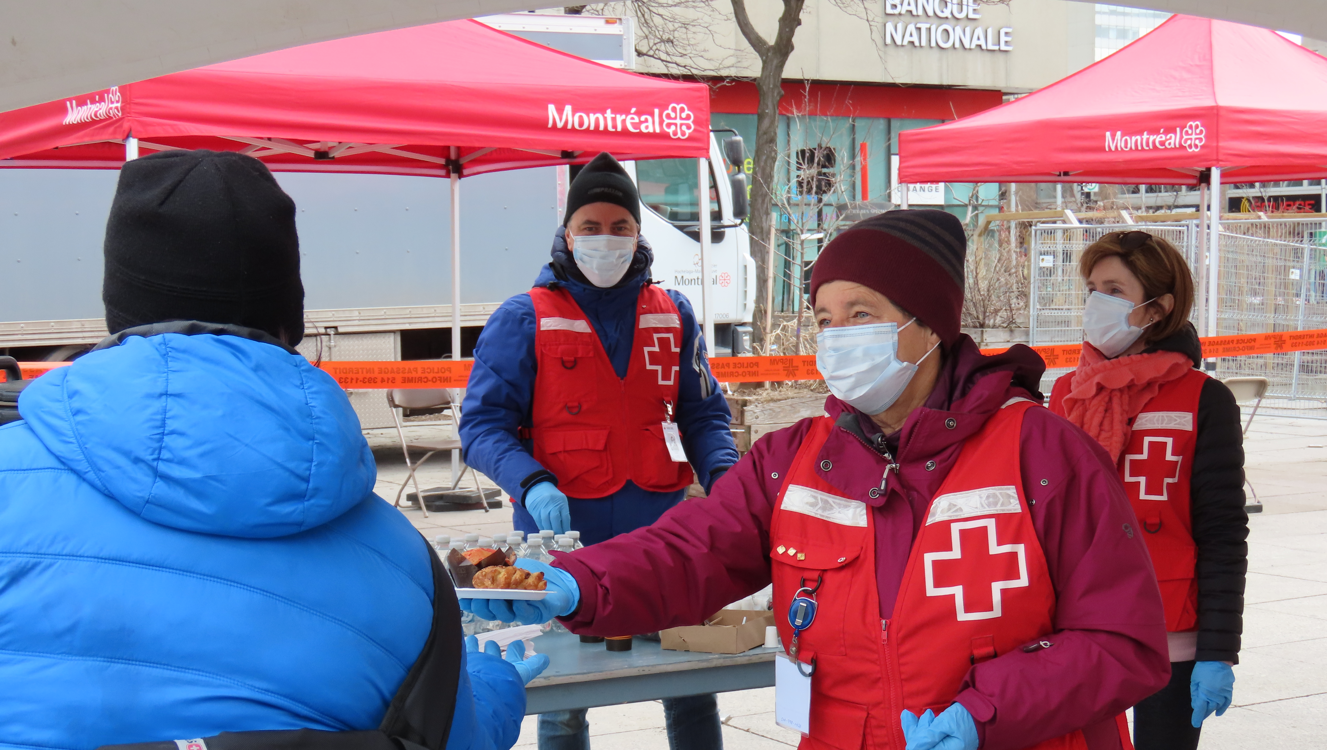

Slide 20
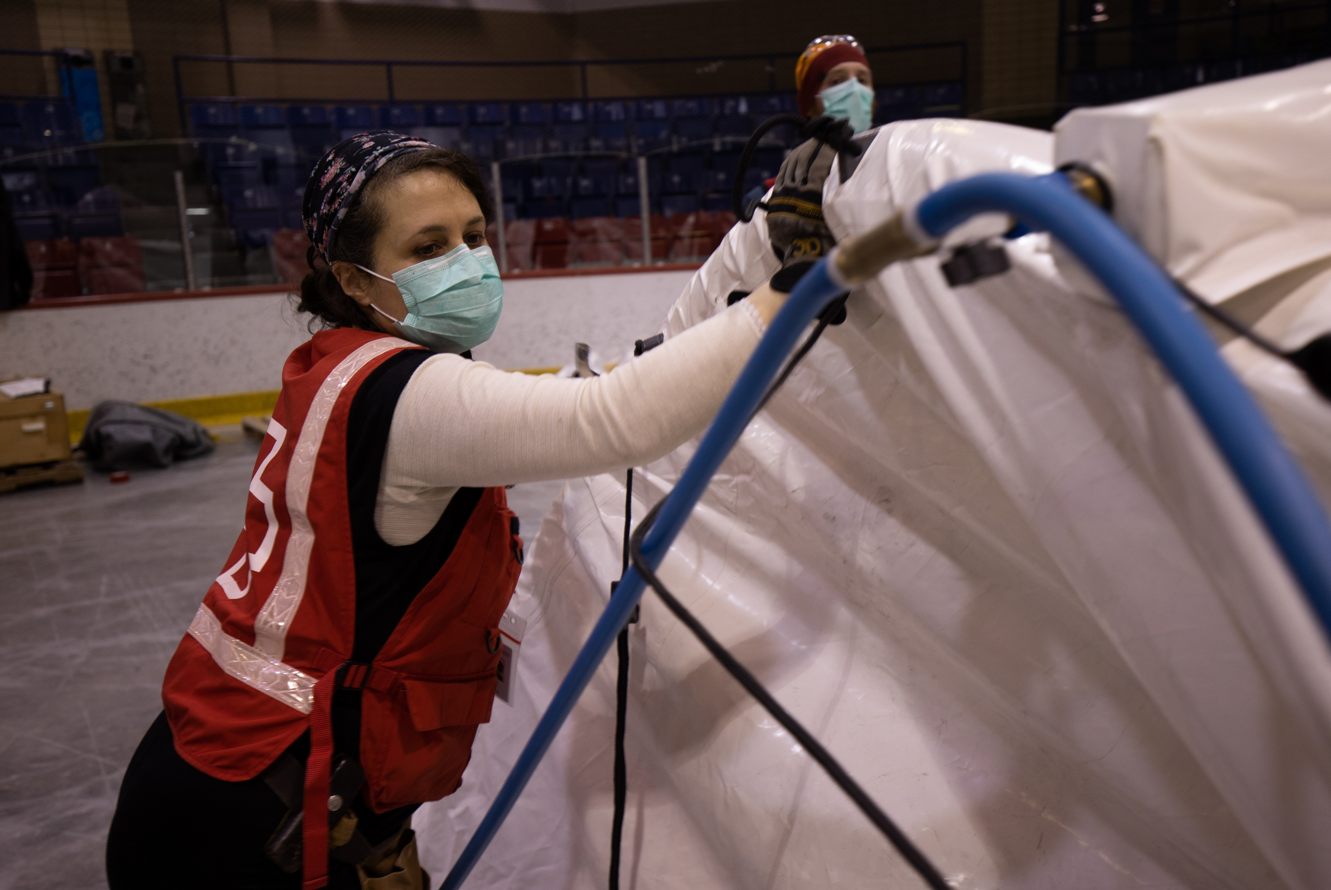
Campaign Logistics

Slide 21
Campaign Logistics
Methods of Store Contact
Available Technology
Comfort Level and Familiarity
Notes:
Primary contact with stores will be made by telephone. Where comfort with and availability of video conferencing (via Zoom, for example) exists, video meetings can also be considered.
Confirm in advance of setting any meetings what your comfort level with various communication tools is.
Be sure to test technologies ahead of time, especially if using a tool or resource that is new to you.
Using a conferencing number and access code or a Philanthropy Zoom account will require scheduling with your provincial CRC staff contact.

Slide 22
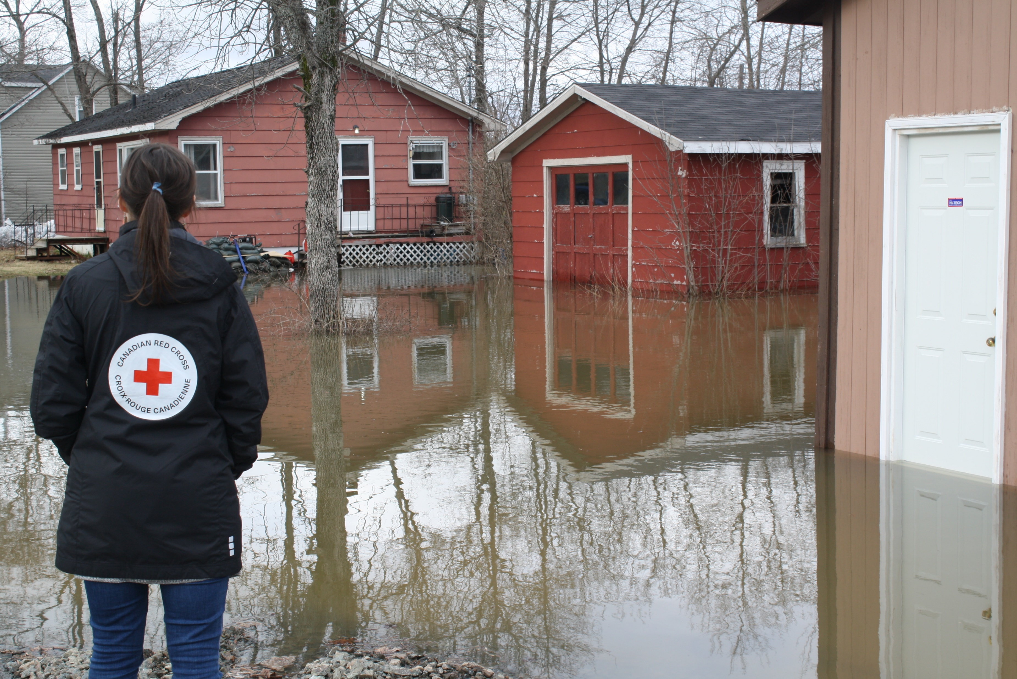
Campaign Reporting

Slide 23
Campaign Reporting & Feedback
Store Contact Information Sheet
Relaying store feedback
Flagging issues
Tracking use of campaign tools
Expenses
Notes:
Ambassadors play a crucial role as the eyes and ears of the campaign. You will receive tools and instructions throughout the campaign to compile and submit feedback from stores based on your interactions as well as your own personal experiences.
Refer to Store Contact Information Sheet.
Information capture will be circulated to Ambassadors via link to Smart Sheet which can be completed by computer or even smart phone.
Expenses: (To include note on how to address this.)

Slide 24
Mission Moment

Slide 25
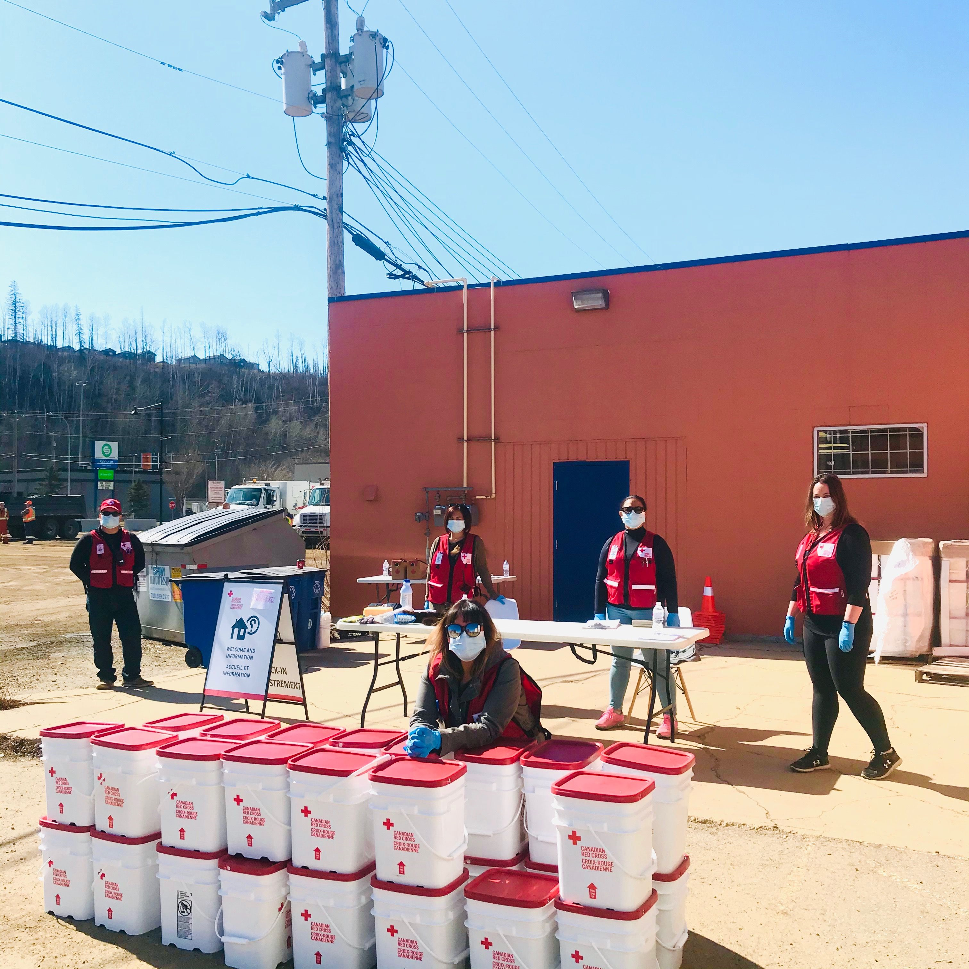
Mission Moment
Example (customize for local training)
Jenn Houtby, International and Domestic Delegate for Canadian Red Cross
Cyclone Idai
Grand Forks Flood 2018
BC Fires 2018
Senior Manager, Communications
Notes:
Impact stories:
Share 1 or 2 stories of how funds are used
Invite EM staff or volunteer to be present for this portion of the call to tell a story.
*If EM staff or volunteers are unavailable to tell a story firsthand, try to have one relay a powerful instance to you to share. Or maybe you have had interactions with beneficiaries that illustrate the impact of our work. ALWAYS be sure to protect privacy of those involved, do not use specific identifiers like name, place, date, etc.

Slide 26
Questions?

Slide 27
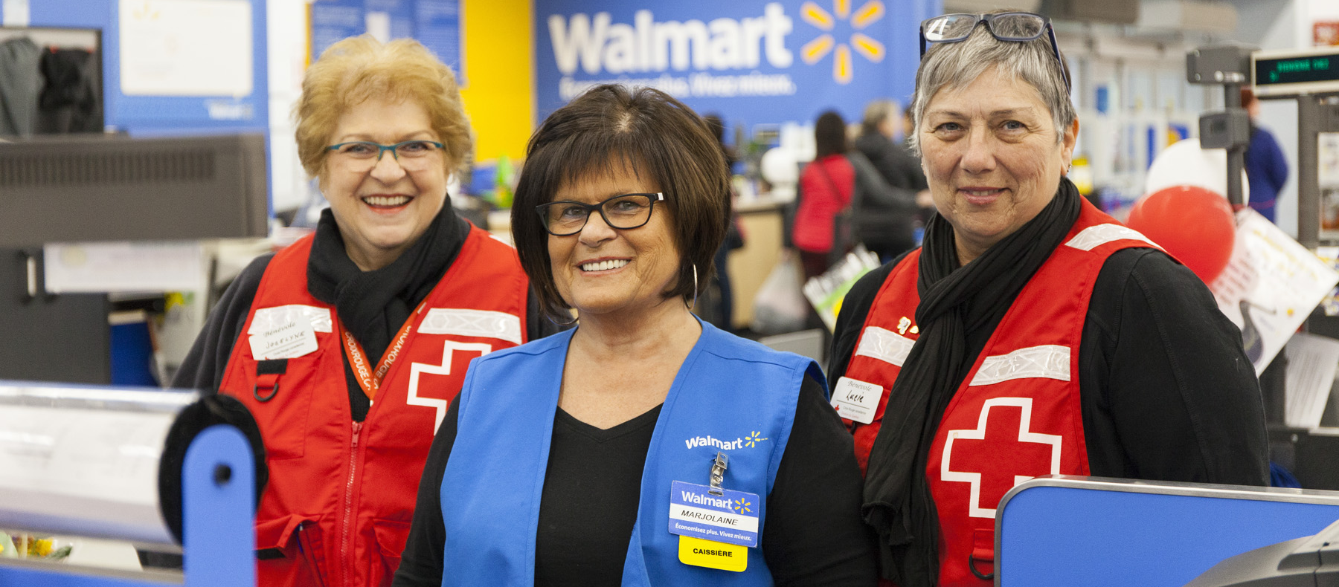
Thank you / Merci

